Slide 1

Battle of the neighborhoods Capstone

Slide 2
Introduction
This project will help us determine and visualise where it is most optimum to establish a steak and grill restaurant in Galway. Galway is situated on the west coast of Ireland with a population greater than 250,000. It is renowned for its vibrant lifestyle and for hosting numerous festivals, celebrations and events such as The Galway Arts Festival. In 2018, it was named the European Region of Gastronomy. The city is currently the European Capital of Culture for 2020, alongside Rijeka, Croatia. Alongside its strong cultural presence, it leads the way in medicine, pharmaceutical research and biomedical multinational companies.
The reason we choose to locate for a steakhouse and grill restaurant is to take advantage of the high quality meat in the west coast of Ireland and the availability of fresh fish from the Atlantic.

Slide 3
data
The data used in this project is taken from readily available data online. We will scrap and then parse this data using the beautifulsoup package.
Location and venue data will then be added using the foursquare api which will help us in our analysis. The report will outline the top ten venues for each neighborhood using the mean count of venues. Ideally we would prefer not to open near another restaurant to avoid competition. The idea would be that the customer base would travel to this location to enjoy the meal. Ample car parking facilities especially away from busy areas would be preferred. Combining traffic location was preferred yet no public free data was available.
We further cluster neighborhoods using the knn algorithm and will post their locations using folium alongside the data from foursquare to infer the data.

Slide 4
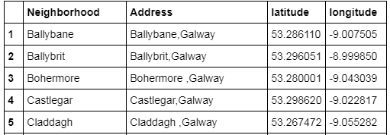
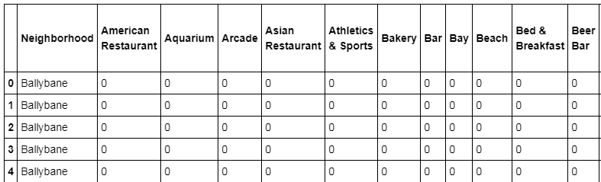
Methodology
Using foursquare api, we extract the venue for each venues using the longitude and latitudes of each neighborhood.
We now go through the logic of the report. Here we extract and clean the data.

Slide 5
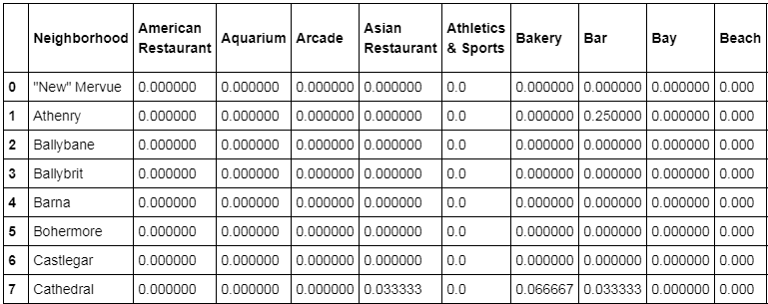
Methodology
Next, we group rows by neighborhood and by taking the mean of the frequency of occurrence of each category.
This helps us rank all venues across the neighborhoods.

Slide 6
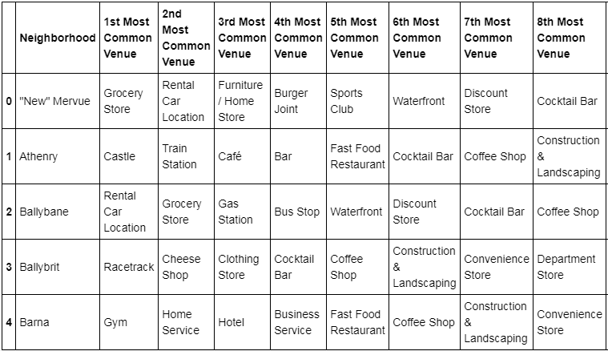
Methodology
Further we sort neighborhoods by ascending venues so that each neighborhood will be ranked from top to bottom venue.

Slide 7
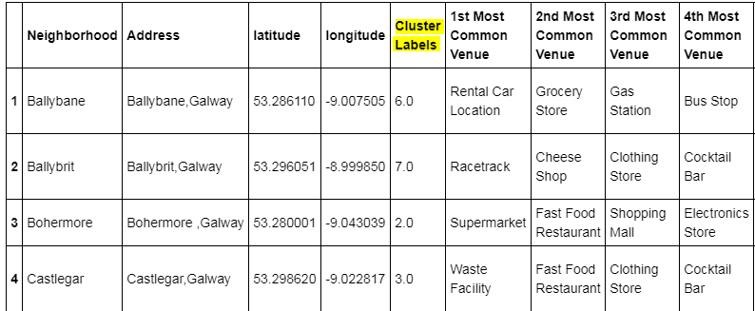
Methodology
Lastly we combine the knn algorithm to our data points and assign them to our data.
Posting a screenshot of the results.

